Slide 1
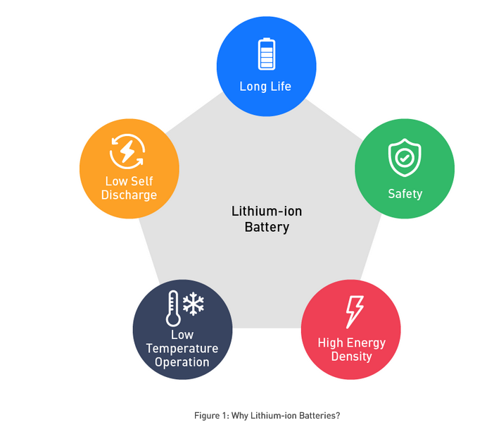
Improving Laptop Battery Usage
1.0 Introduction
Purpose: Enhance laptop battery usage
Focus: Short battery life reduces productivity
2.0 Problem
2.1 Battery drains quickly
Fast battery drain during long sessions
Multiple apps & background process
Work interruptions & shutdowns
2.2 Solution
Battery Management System & Lithium-Iron Battery
Finds high-power apps
Adjust brightness & CPU settings
3.0 Criteria
3.1 Improvement of battery life
3.2 User-friendly and cost-effective
3.3 Reliability across devices
Figure 1: Lithium-ion Battery Performance Features
Reference: https://www.monolithicpower.com/en/learning/resources/how-lithium-ion-battery-management-systems-enhance-battery-performance

